Slide 1
Customer Churn Prediction
Your Name - Date

Slide 2
Project Overview
Objective: Develop a model to predict customer churn
Industry: Telecommunications
Goal: Reduce churn, improve retention

Slide 3
Data Overview
Dataset: Telco Churn (7,043 entries, 21 columns)
Key Feature: Tenure
Key Feature: MonthlyCharges
Key Feature: TotalCharges
Key Feature: Contract Type
Key Feature: Payment Method

Slide 4
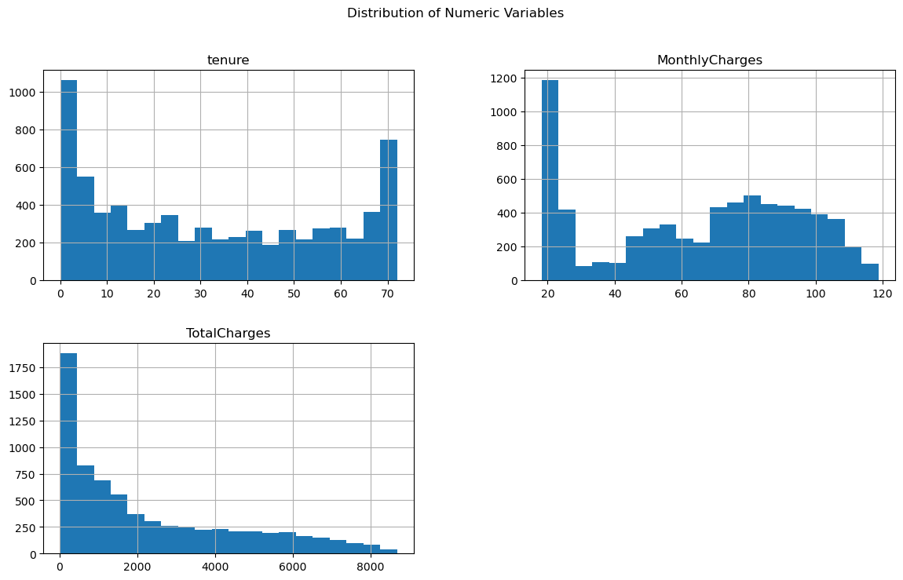
EDA: Tenure Distribution

Slide 5
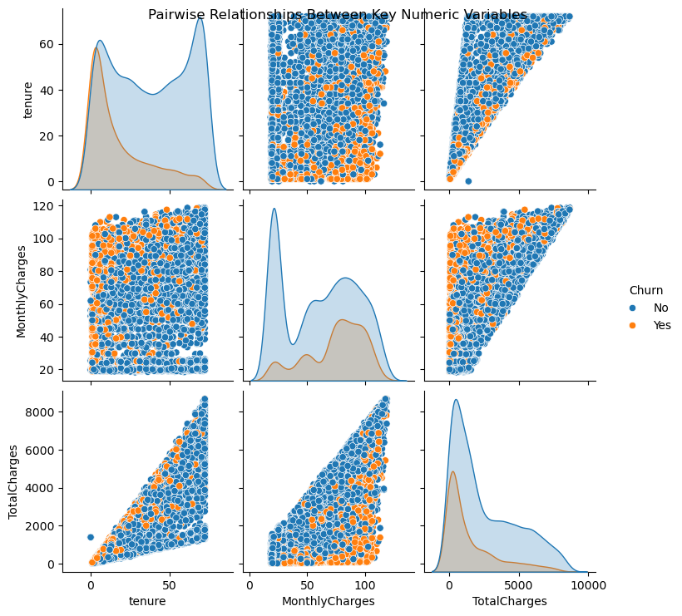
EDA: Pairwise Relationships

Slide 6
Model Performance Summary
Logistic Regression: Acc=0.811, Prec=0.686, Recall=0.563, F1=0.618, AUC=0.857
Random Forest: Acc=0.792, Prec=0.721, Recall=0.383, F1=0.501, AUC=0.852
XGBoost: Acc=0.806, Prec=0.686, Recall=0.528, F1=0.596, AUC=0.857 (Best)

Slide 7
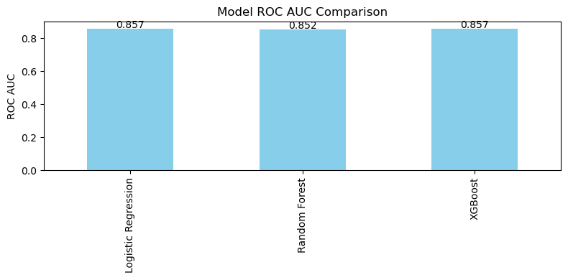
Model ROC AUC Comparison

Slide 8
Recommendations
1. Target High-Risk Customers
2. Promote Long-Term Contracts
3. Billing Support Programs

Slide 9
Further Research
• Time Series Analysis
• Additional Customer Touchpoints
• A/B Testing Strategies

Slide 10
Conclusion
XGBoost achieved best ROC AUC of 0.857.
Next Steps: refine model with additional features

